Slide 1
Kunstsvømning/
Artistic Swimming
Season 25/26, parents meeting 01.09.25

Slide 2
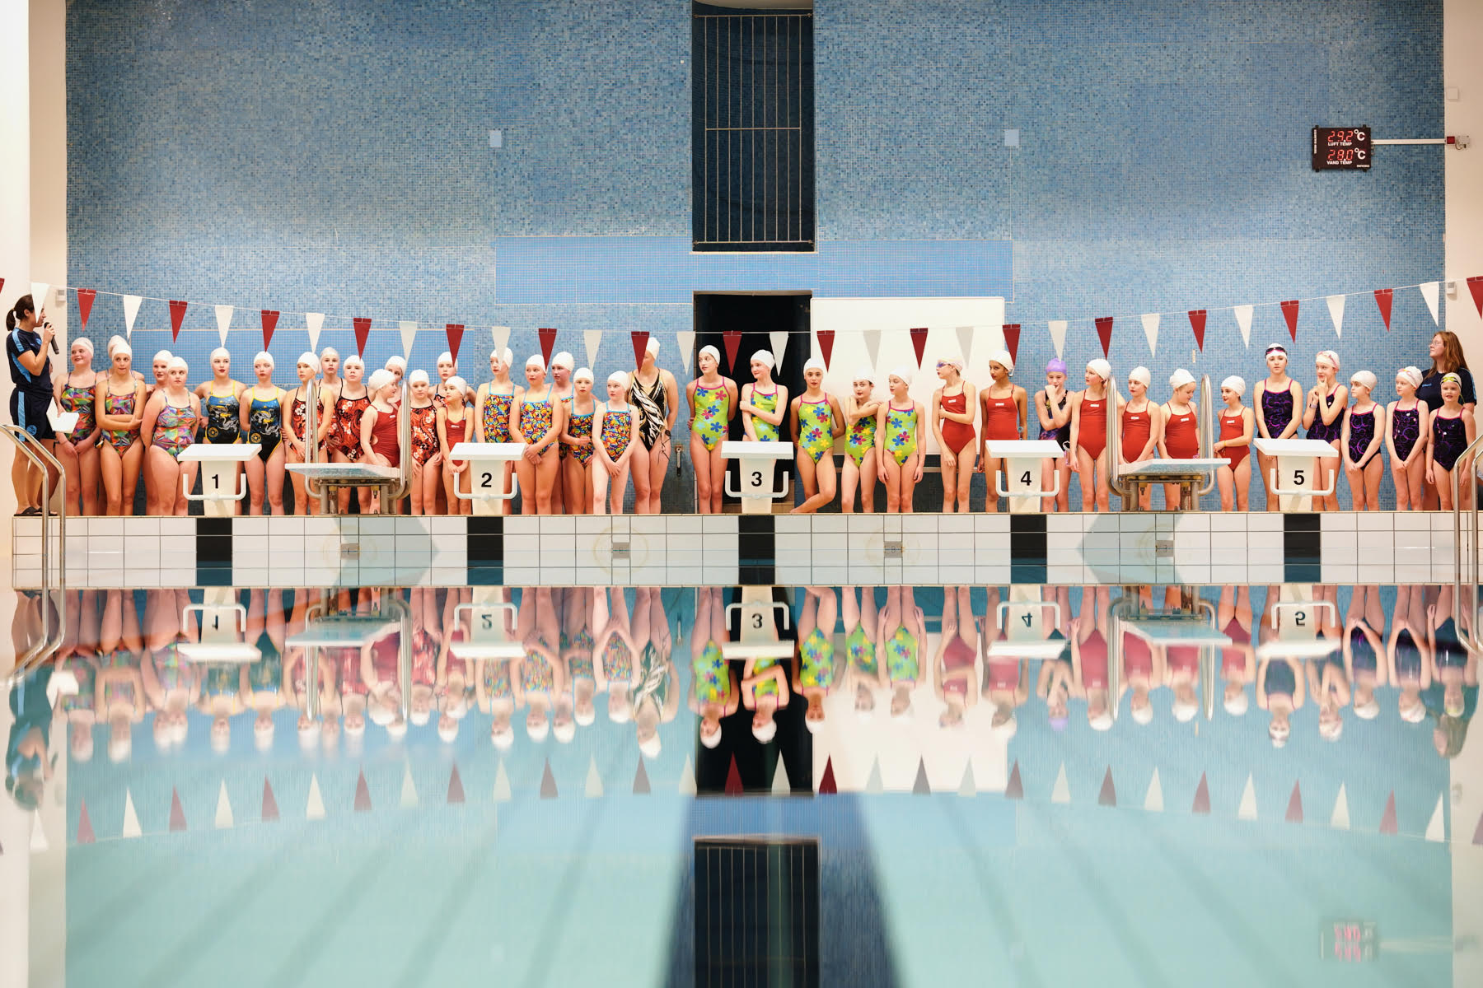
Agenda
Artistic swimming in HSK
Calendar
Tasks for parents
Where to find information?

Slide 3
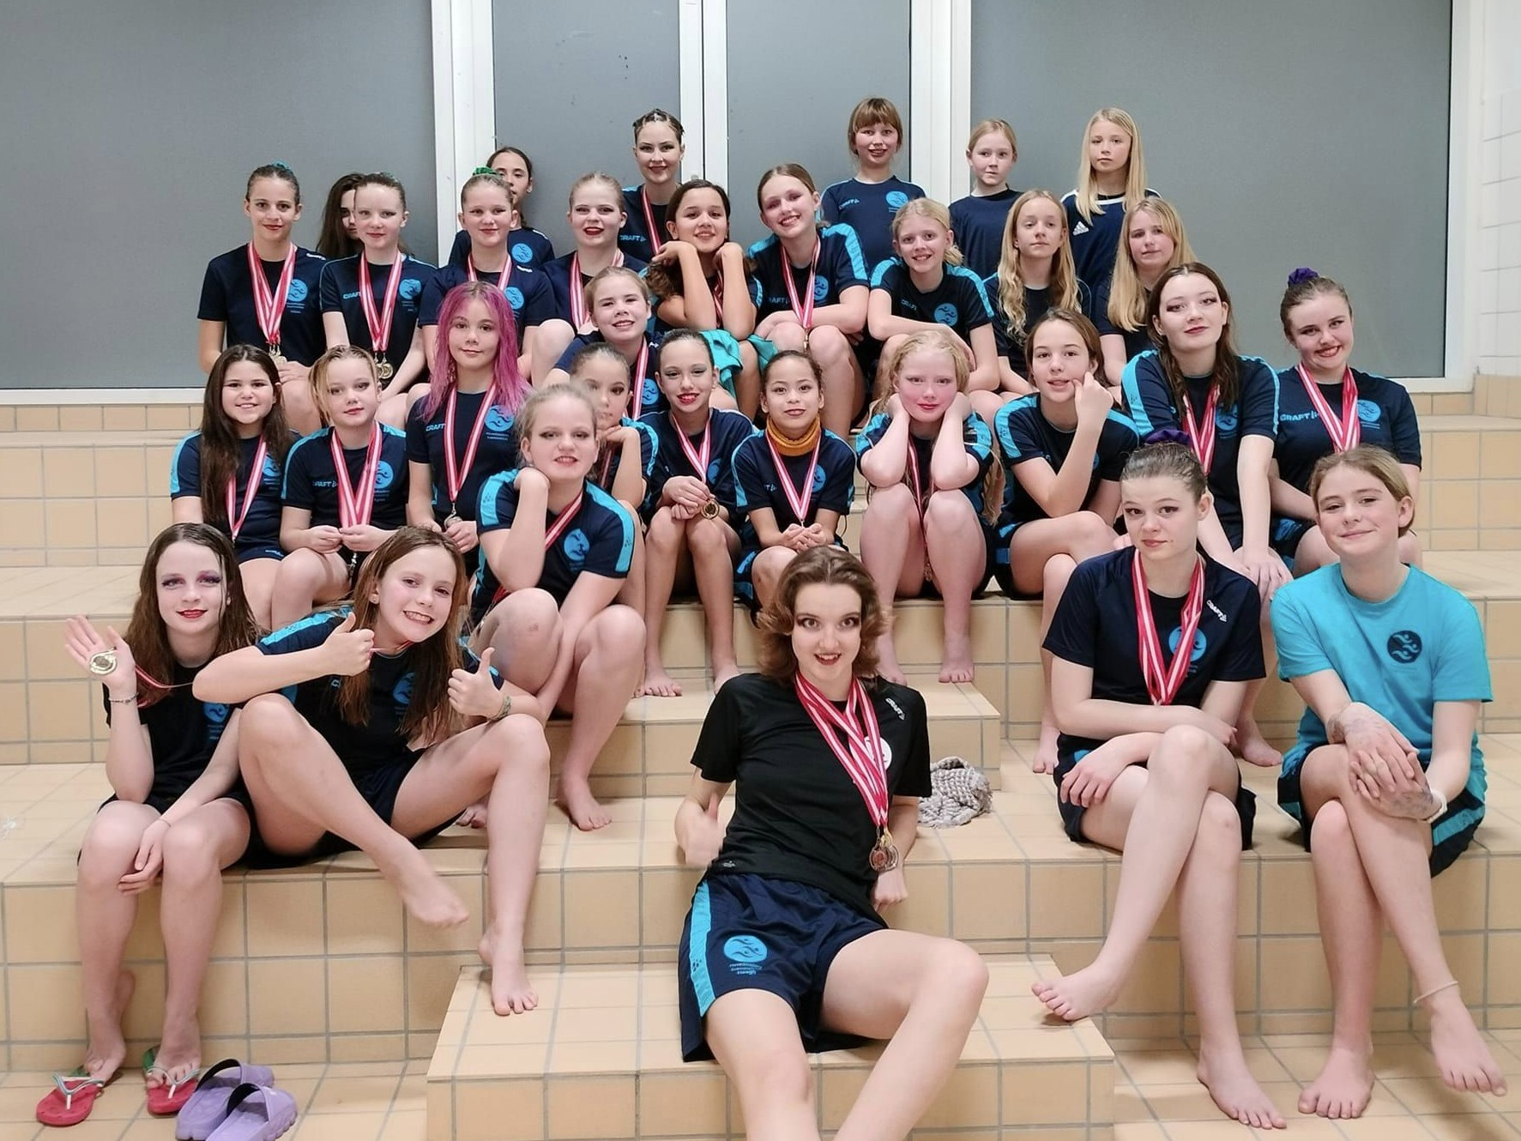
Artistic Swimming in HSK
Hovedstadens Svømmeklub (HSK)
- a democratic non-profit association committed to public education and community development.
Based on the follwing values:
Community
Joy
Engagement
Swimming for everyone
Quality

Slide 4
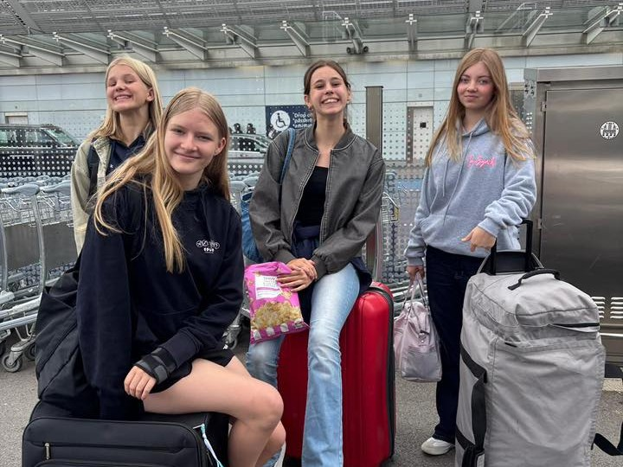
Artistic Swimming in HSK
A competitive sport – swimmers take part in meets and competitions all over the country
A team sport – about precision, creativity, and teamwork, swimmers rely on each other to succeed
A community sport –involvement and encouragement from parents is crucial for the swimmers’ experience

Slide 5
Calendar
No competitions in 2025.
Christmas Show in December. All swimmers.
31.01: ØDM, Østdanske Mesterskaber, Jyllinge. All swimmers.
14.03: DÅM/DJM, Dansk Årgangsmesterskab, Hobro. Experienced swimmers.
09.05: ABCD(Be), Snedsted. All swimmers.
Maybe a social/training event in the fall?
Maybe a training weekend in January leading up to ØDM?

Slide 6
Tasks for parents
Tovholder/team coordinator
Holdleder/team leader
Dommere/Judges
Help with practical stuff at competitions

Slide 7
Team coordinator
Participates in the artistic swimming committee
Responsible for planning and organising parents for competitions and training camps
Facilitates (but does not organize) social activities
Point of contact for parents
WORK LOAD:
Meetings with the committee (4-6 per season)
Communication with team leaders starting 1-2 weeks before competitions
Assigning tasks for parents before competitions

Slide 8
Team leader
Supports coaches during competitions (allows the coaches to focus on performance)
  Handles all logistics and practical matters
  Supervises the swimmers
WORK LOAD:
Communication and planning with team leaders/coaches 1-2 weeks before competitions
Being on-site and available during competitions:
  Keep track of the swimmer’s schedule (make sure they’re ready)
  Assist swimmers with hair and makeup
  Make sure all swimmers feel comfortable and included

Slide 9
Judges and controllers
Depending on the number of participants, we need to provide judges and controllers for each competition. We are fined if we don’t bring enough.
Artistic Impression Judge (choreography and presentation) – if you enjoy creativity and variation.
Element Judge (technical execution of lifts/hybrids) — if you enjoy structured, measurable observations.
Chief Recorder (Manages scoring software) — if you enjoy Excel and behind-the-scenes tasks.
Judges’ training: October 4–5 in Odense
Level 1: October 4
Level 2: October 5
Controller courses are September 13th & 14th and 20th & 21st.

Slide 10
Artistic Swimming committee
Coordinate participation in competitions and training camps
Plan joint social activities (Christmas, End-of-season, Kick-off)
Organise competitions (but NOT in 25/26)
Handle communication with HSK HQ and the Artistic Swimming community
Manage budget and set priorities
Appoint an HSK board member and a deputy
Come up with new ideas for activities, communication, sponsorships etc.
Everyone is welcome – swimmers included!

Slide 11
Where to find information
Practical stuff (payment, membership, etc.): https://www.hsk.dk/
Artistic Swimming in HSK: https://www.hsk.dk/boern-og-unge/kunstsvoemning/
Day-to-day: Messenger groups for each level.
Cancellations etc.: Text messages from HSK (one way).
Facebook “Synkro HSK”. Our place for events, info, and random questions.
Any issues: kunstudvalgsforperson@hsk.dk (Artistic Swimming committee/Tore).

